Slide 1
Information technology, the Internet, and You
1

Slide 2
Learning Objectives
Explain the parts of an information system: people, procedures, software, hardware, data, and the Internet.
Distinguish between system software and application software.
Differentiate between the kinds of system software programs.
Define and compare general purpose, specialized, and mobile applications.

Slide 3
Learning Objectives cont.
Identify the four types of computers and the four types of personal computers.
Describe the different types of computer hardware, including the system unit, input, output, storage, and communication devices.
Define data and describe document, worksheet, database, and presentation files.
Explain computer connectivity, the wireless revolution, the Internet, and cloud computing.

Slide 4
Introduction
Personal computers are common life tools
New forms of learning have developed
College courses
Not just quarters or semesters
Computers offer many communication avenues

Slide 5
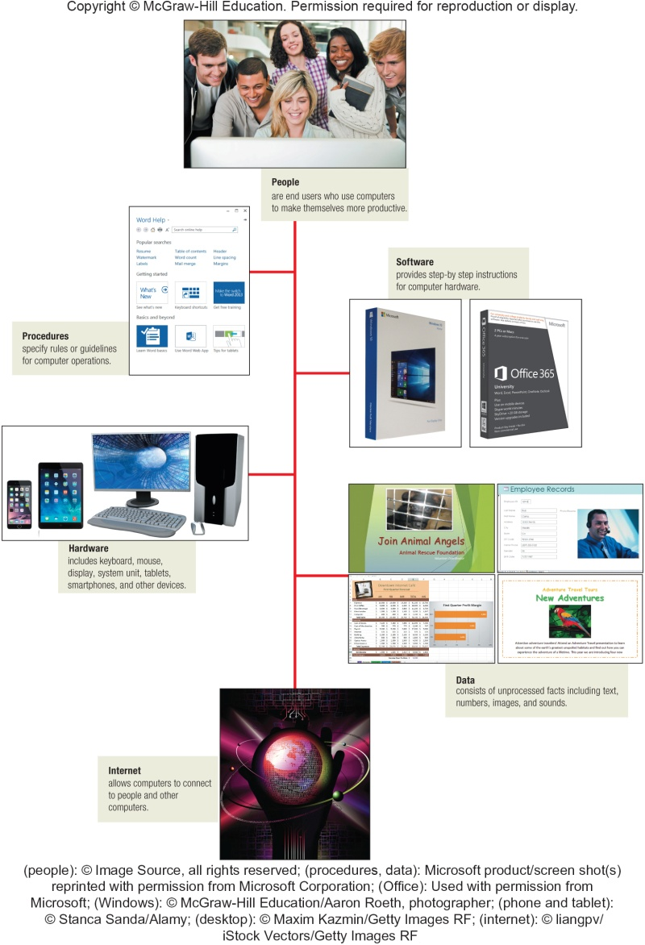
Parts of an Information System
People
Procedures
Software
Hardware
Data
The Internet
Notes:
An information system (Key Term) is a combination of people, procedures (key term) , software (key term) , hardware (key term) , data (key term) , and the Internet (key term).
Some students may think of a system as pertaining to just the hardware
Remind them that a personal computer is part of an information system as well as people
Almost all of today’s computer systems add an additional part, communication/the Internet.
To be a competent end user (Key Term), one must understand the essentials of IT
Note that IT stands for information technology (Key Term)
All of these parts will be discussed in the following slides – beginning with the most essential part: people

Slide 6
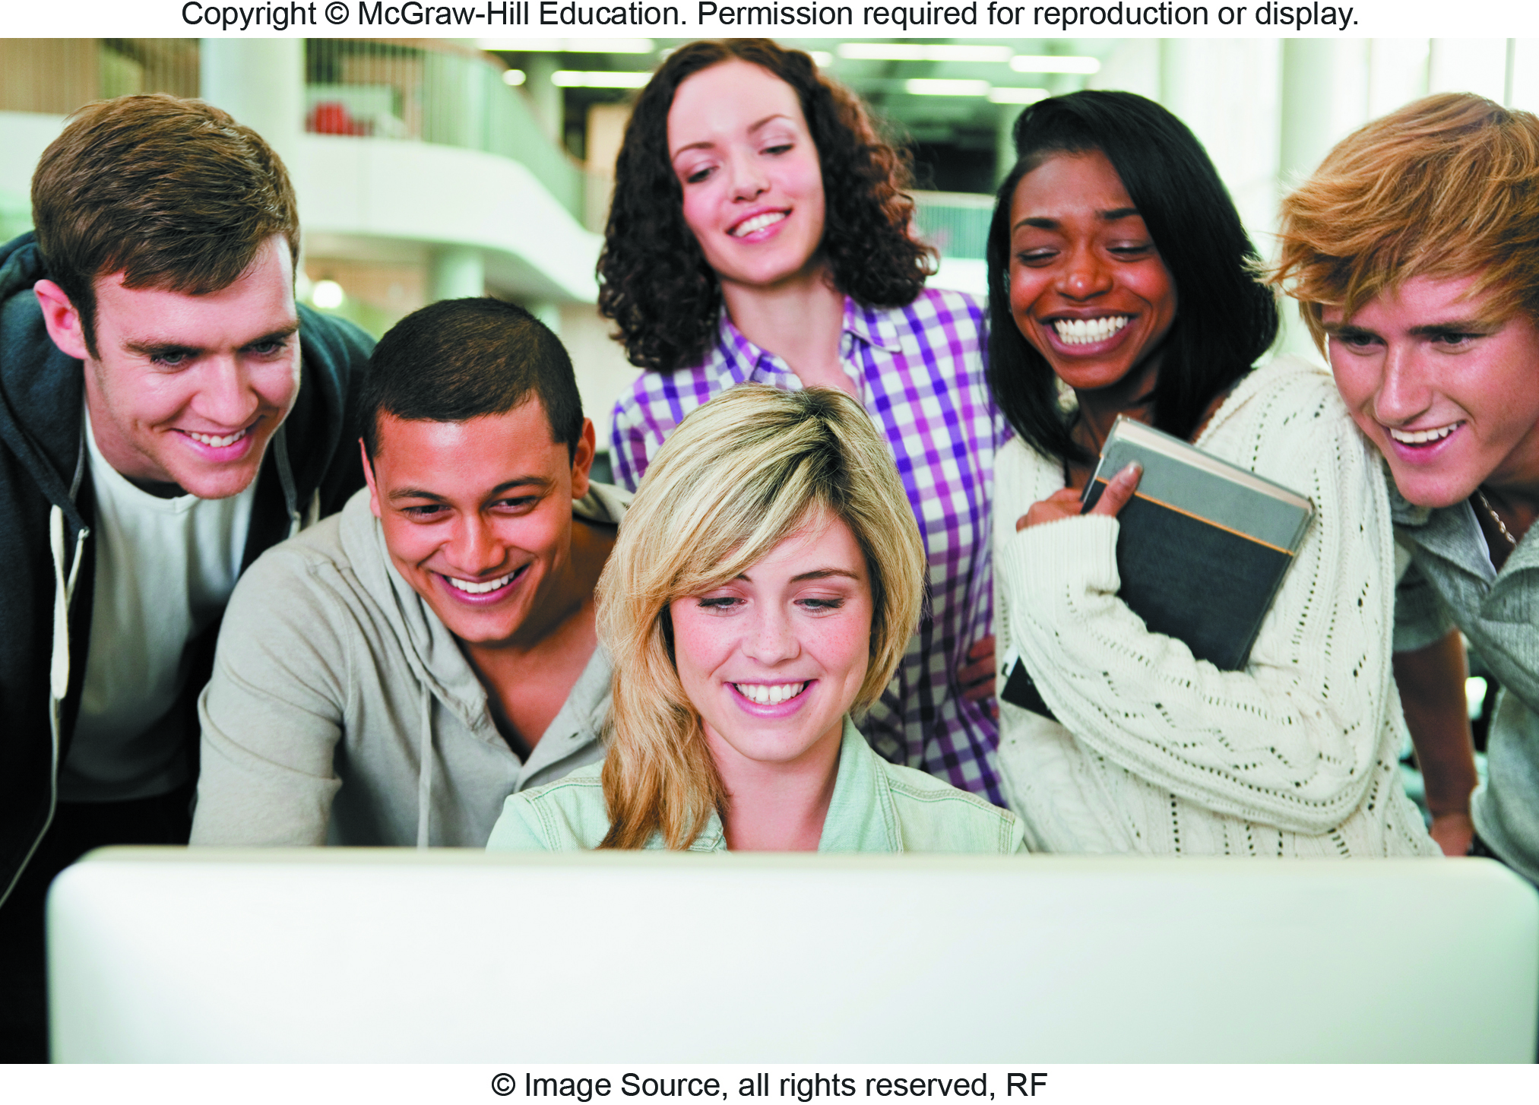
People
End users who use computers
Most important part of any system
Contact is
Direct
Indirect
Notes:
People (Key Term) or End Users are the most important part of an information system but easy to overlook
Our lives are touched everyday by computers- many time the contact is direct and obvious, such as creating documents using a word processing program or when connecting to the Internet. Other times, it isn’t as obvious and is much more indirect as shown in a couple of the pictures
Have students give examples of how they use computer applications throughout the day
Some examples are:
Free Antivirus Programs
Online Entertainment
Google Docs
SKYPE
Cloud Storage

Slide 7
Software
Another name for programs
There are two major kinds of software:
System Software
Software used by computers
Application Software
Software you use
The purpose of software
Convert data into information
Notes:
Software (Key Term) is another name for programs\ (Key Term) – in most cases these terms are interchangeable
Programs are instructions that tell the computer how to process data (Key Term) into the form you want
Two major kinds of software: System and Application
Emphasize differences between application and systems software
System software (Key Term) – computer uses
Application software (key term) – software you use

Slide 8
System Software
Enables application software to interact with the computer hardware
Background software helps manage resources
Collection of system programs
Operating Systems
Utilities
Device Drivers
Notes:
System
A collection of programs – Operating System, Utilities and Device Drivers

Slide 9
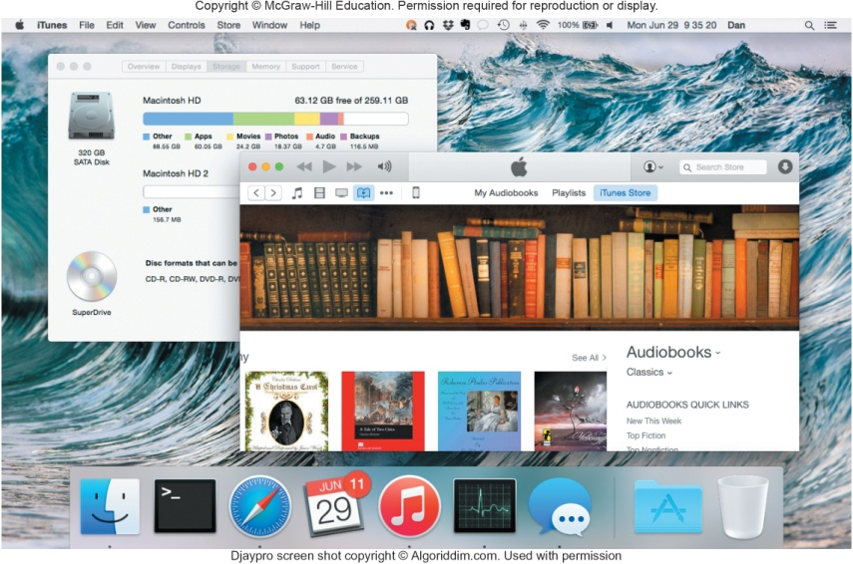
System Software cont.
Operating System
Coordinates computer resources
Provides the user interface
Runs applications
Embedded operating system
Used by Smartphones and tablets
Real-time operating systems (RTOS)
Standalone operating system
Used by desktops
Networking operating systems
Used to run networks
Notes:
Operating System (key term)
Coordinates computer resources
Provides an interface between users and the computer
Runs applications
Two best known Operating systems are:
Windows 8
Apple’s Mac OS X

Slide 10
System Software Continued
Utilities
Perform specific tasks related to managing computer resources
Antivirus Program
Protects from viruses
Can damage your software or hardware
Comprise the security and privacy of personal data
Notes:
Utilities (key term)
Performs tasks related to managing computer resources
Most essential utility program is antivirus program to protect your system from viruses (Key term) or malicious programs that can damage your software or hardware as well as compromise the security and privacy or your personal data
See how you can install a free antivirus program on your computer – Making IT Work for You: Free Antivirus Program on page 10

Slide 11
Application Software
End-user software
Types of application software
General-Purpose applications
Widely used programs
Browsers
Word Processor
Specialized applications
More narrowly focused
Web Authoring
Apps
Designed for mobile devices
Social media apps
Notes:
“End-user” (Key Term) software – these are the types of programs you have to know to be considered computer competent
Three types of application software
General-Purpose applications (key term) - general purpose or “off-the-shelf” programs, such as Microsoft Word, Excel, Access and PowerPoint
Specialized application (key term)– narrow focus on specific disciplines and occupations, such as graphics and Web authoring
Mobile Apps (key term)– or apps (key term)– designed for mobile devices (key term) or tablets for social networking, games, music, and video

Slide 12
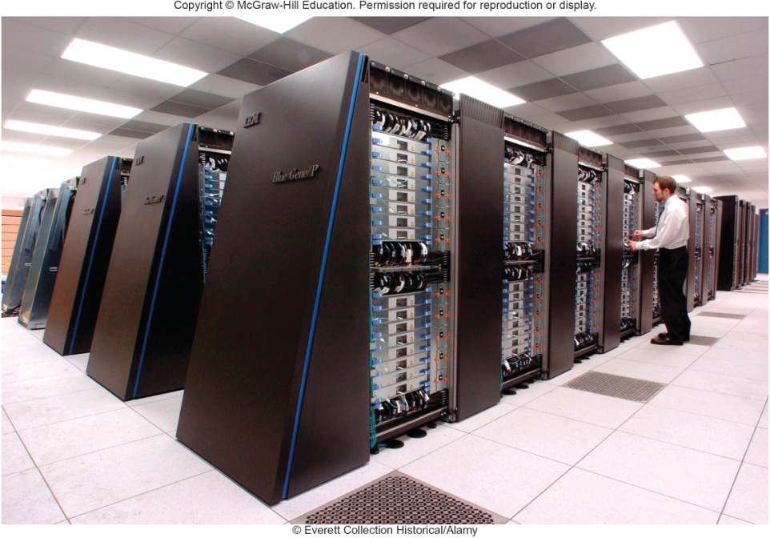
Hardware – Types of Computers
Supercomputers
Most powerful computers
Mainframe computers
Process large amounts of data
Midrange computers
Servers
Personal computers
PCs
Five types of PCs
Notes:
There are four types of computers
Supercomputers (key term) – the most powerful; special high-capacity computers used in very large corporations
Mainframe computers (key term) – are capable of great processing speed and data storage; occupy specially wired, air-conditioned rooms; insurance companies use to process information about millions of policyholders
Midrange computers (key term) - known as servers (key term), are computers with processing capabilities less powerful than a mainframe computer yet more powerful than a personal computer. Today they are used to support or serve end users for specific needs such a retrieving data from a database or supplying access to application software.
Personal computers or pcs (key term) – least powerful but most widely used and fastest-growing type of computers. There are five (5) types of pcs.

Slide 13
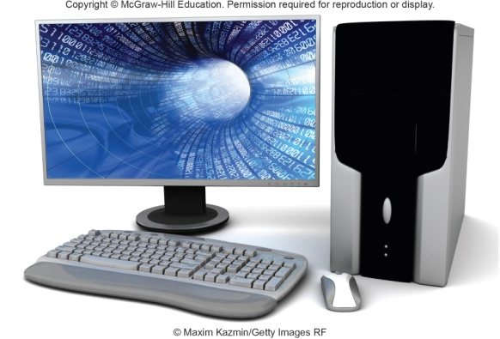
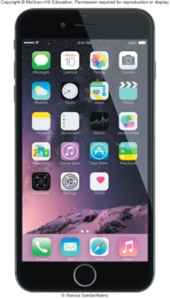
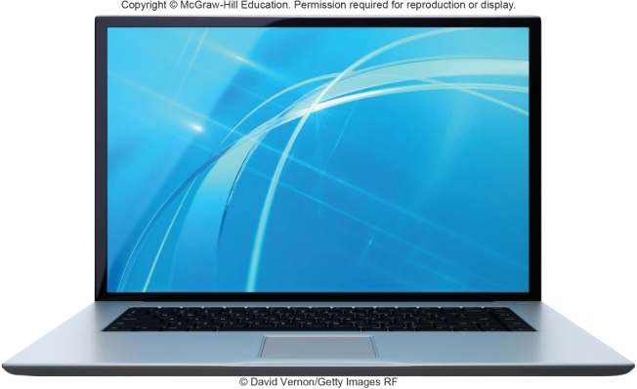
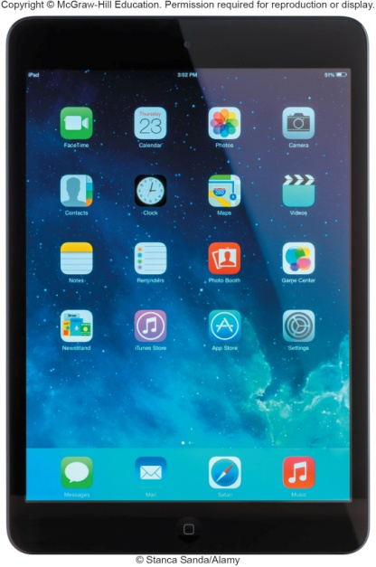
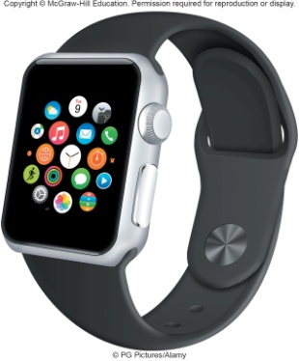
Personal Computer Types
Desktop
Laptop (Notebook)
Tablet
Smartphones
Wearables
Notes:
Desktop (key term) – small enough to fit on top of a desk yet too big to carry around
Laptop (key term) – or notebook computers (key term) are portable, lightweight and bit into most briefcases
Tablet (key term) – iPad for example, are smaller, lighter and less powerful than laptops and use a virtual keyboard.
Smartphones (key term) is the most common handheld
Wearables – such as the Apple Watch

Slide 14
Personal Computer Hardware
Four basic categories of equipment
System Unit
Input/Output
Secondary Storage
Communications
Notes:
System Unit (key term) is the container that houses most of the electronic components that make up a computer system.
Input/Output – Input devices (key term) translate data and programs from a form humans understand to a form computers can process; Output devices (key term) translate the processed information from the computer into a form that humans can understand
Secondary Storage (key term) – Unlike memory (key term), secondary storage holds data and programs even after the electrical power has been turned off—examples of secondary storage include USB drives, hard drives and optical drives
Communication – one computer communicating with another computer or other computer systems using communication devices (key term) such as a modem (key term)

Slide 15
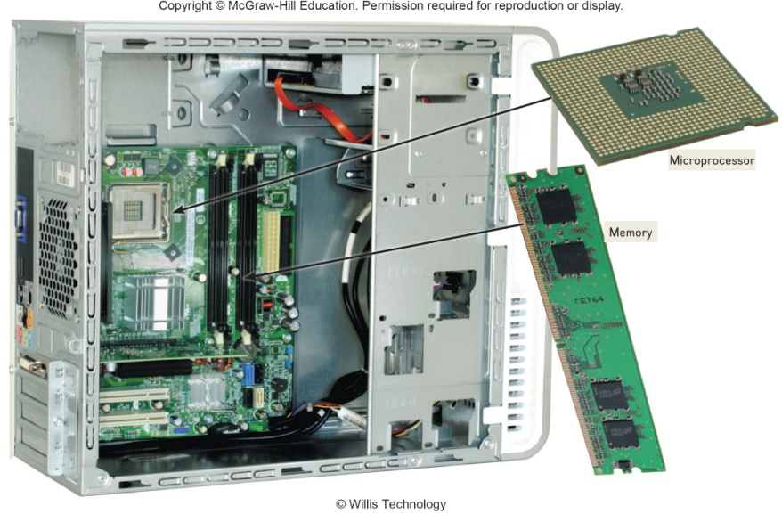
System Unit
System Unit
Houses most of the electronic components
Two important components
Microprocessor
Memory
Holds data currently being processed
Holds the processed information before it is output
Temporary storage, contents are lost when power is off
Notes:
Two important components of the System Unit are the Microprocessor (key term) which controls and manipulates data to produce information and Memory (key term) which is a holding area for data, instructions, and information.
RAM or random-access memory (key term) is one type of memory that holds the program and data that is currently being processed. This is temporary storage because the contents are lost when the power is turned off

Slide 16
Input/Output Devices
Input
Translate data into computer language
Keyboard and Mouse
Output
Translate computer data into usable information
Display and Printer
Notes:
Input devices translate data and programs that humans can understand into a form that the computer can process.
The most common input devices are the keyboard (key term) and mouse (key term)
Output devices translate the processed information from the computer into a form that humans can understand.
The most common output device is a display (key term) or monitor (key term)

Slide 17
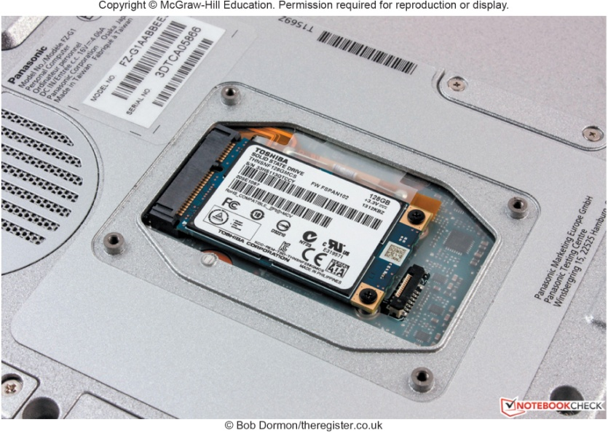
Secondary Storage
Holds data and programs even if power is off
Hard disk
Solid-state storage
No moving parts
More reliable
Requires less power
Optical disc
Laser technology
CDs, DVDs, Blu-ray
Notes:
Unlike memory, secondary storage holds data and programs even if power is off
Hard disks (key term) are typically used to store programs and data files. They use rigid metallic platters and read/write heads for writing and reading data
Solid-state storage(key term) does not have any moving parts, is more reliable, and requires less power to operate.
Similar to RAM but not volatile
Optical disks (key term) use laser technology and have the greatest capacity.
Examples of optical disks include:
compact discs (CDs) (Key Term)
digital versatile or video discs (DVDs) (Key Term)
Blu-ray (Key Term) discs

Slide 18
Communications
Communication devices
Provide the ability for personal computers to communicate
Modems
Modify audio, video and other types of data for Internet usage
Notes:
Communication devices all a personal computers to communication with another as near as the next office or as far away as the other side of the world.

Slide 19
Data
Raw, unprocessed facts
Processed data becomes information
Digital data is stored electronically in files
Four common types of files
Document
Worksheet
Database
Presentation
Notes:
Data is raw, unprocessed facts, that can be stored electronically in files.
Processed data becomes information (key term).
Four common types of files include:
Document files (key term) –
Worksheet files (key term)
Database files (key term) –
Presentation files (key term) –

Slide 20

Document Files
Created by word processors
Term papers
Memos
Letters
Notes:
Created by word processors to save documents such as memos, term papers, and letters.

Slide 21
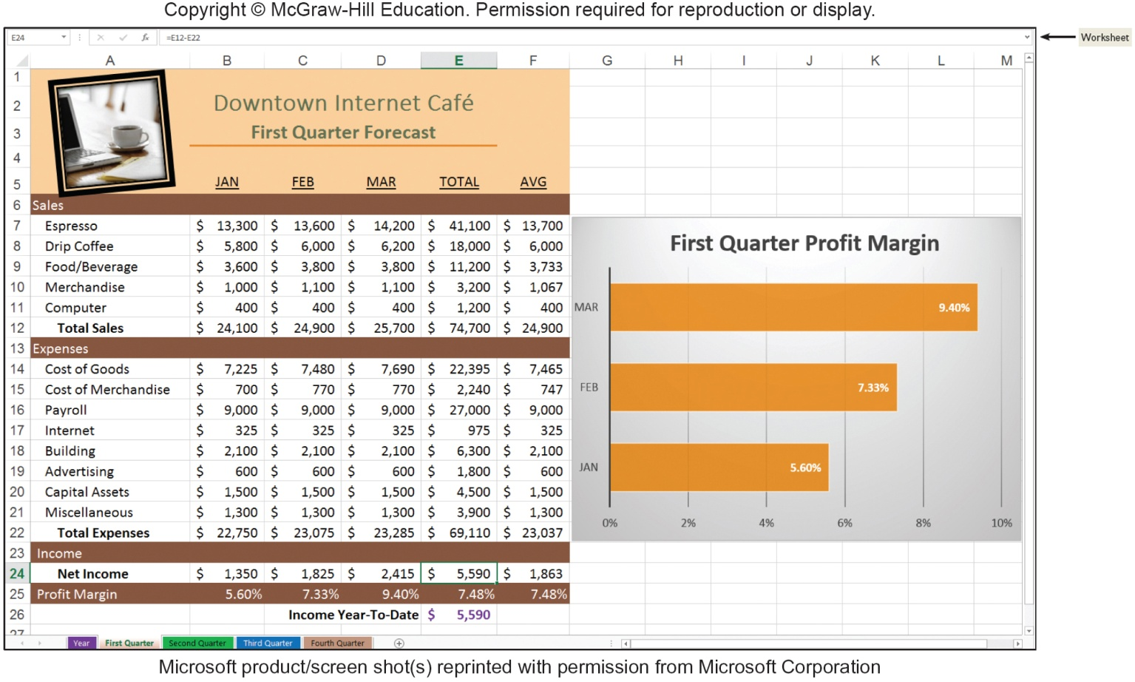
Worksheet Files
Created by electronic spreadsheets to analyze things like budgets and to predict sales
Notes:
Worksheet files are created by electronic spreadsheets to analyze things like budgets and to predicts sales

Slide 22
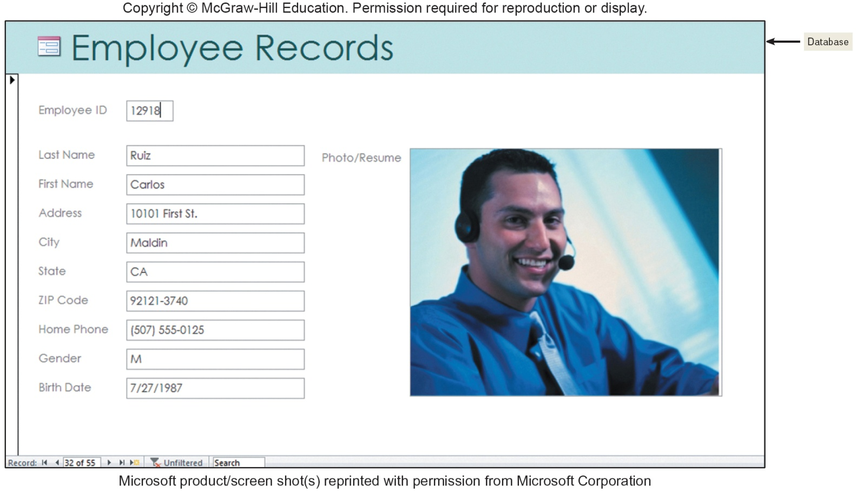
Database Files
Typically created by database management programs to contain highly structured and organized data
Notes:
Database files
Typically created by database management programs
Contain highly structured and organized files

Slide 23
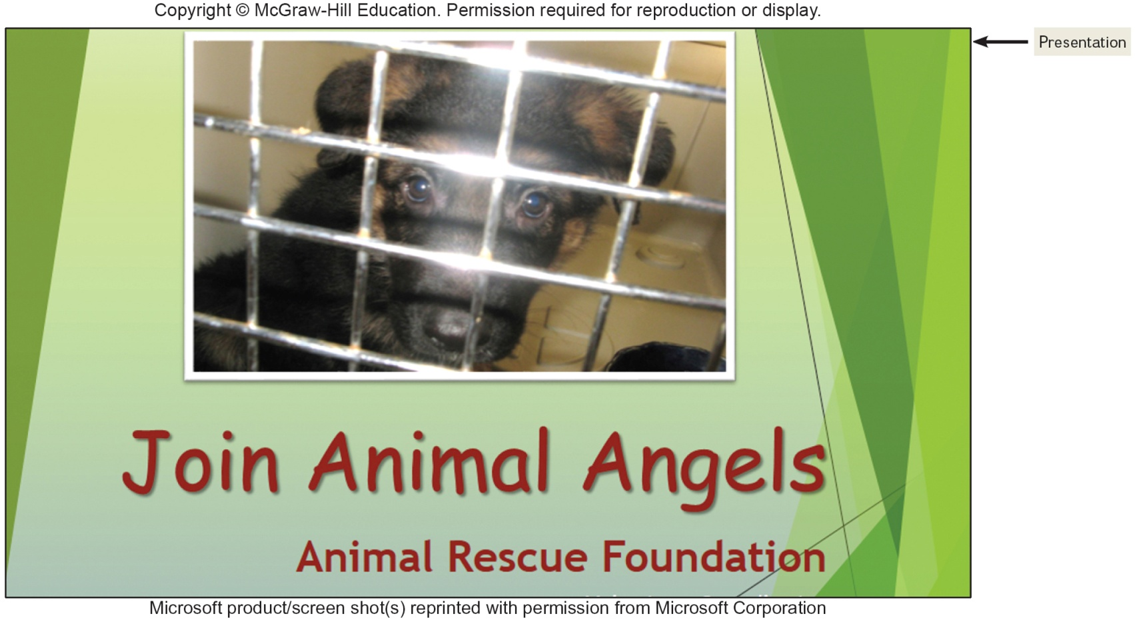
Presentation Files
Created by presentation graphics programs to prepare presentation materials.
Notes:
Presentation Files – created by presentation graphics programs to save presentation materials

Slide 24
Connectivity and the Mobile Internet
Connectivity
Sharing of information
Network
Communications system connecting two or more devices
Central to the concept of connectivity
Largest network is the Internet
Web provides a multimedia interface for Internet resources
Notes:
Connectivity (key term) is the capability of your personal computer to share information with other computers
Wireless /mobile communication and cloud computing over the past 5 years has been the 2 most dramatic changes in connectivity.
A network (key term) is central to the concept of connectivity
A network is a communication system connecting two or more computers.
Ask students questions about the Internet. Here are some facts:
No one owns the Internet
There is no Internet, Inc.
The Internet is the largest network
The Word Wide Web (key term) (WWW) provides multimedia interface to resources on the Internet
Cloud computing can be used to create and store your work, such as documents, spreadsheets, databases, and presentations
The Wireless Revolution (key term) and cloud computing promise the potential to dramatically affect the entire computer industry and how you interact with computer.

Slide 25
Connectivity cont.
Three things driving the forces of technology
Cloud computing
Computers on the Internet
Access to more resources
Wireless technology
Changing the way we communicate
Tablets, smartphones, wearable devices
The Internet of Things (IoT)
Continuing development of the Internet
Allowing all types of devices to communicate

Slide 26
Careers in IT
Each chapter highlights careers in IT
Webmaster – page 48
Develops and maintains websites and web resources
Software Engineer – page 77
Analyzes users’ needs and creates application software
Computer Support Specialist – page 104
Provides technical support to customers and other users

Slide 27
Careers in IT cont.
Computer Technician – page 130
Repairs and install computer components and systems
Technical Writer – page 161
Prepares instruction manuals, technical reports, and other scientific or technical documents
Network Administrator – page 212
Creates and maintains computer networks

Slide 28

A Look to the Future
Using and Understanding Information Technology
The Internet and the Web
Powerful Software
Powerful Hardware
Security, Privacy and Ethics
Organizations
Changing Times
Notes:
Internet & Web - browse the Web, communicate with others, locate Information, etc.
Powerful Software - create professional looking documents, analyze massive amounts of data, create dynamic multimedia pages, and more.
Powerful Hardware – more powerful & robust, new technologies such as wireless networks & their impact to connect, equipment can be dynamic vs. essential features of devices remain unchanged
Security, Privacy & Ethics – need to be careful of the negative potential effect.
Organizations – rely on quality and flexibility to stay competitive
Changing Times – fast paced era and rapid change

Slide 29
Open-Ended Questions (Page 1 of 2)
Explain the parts of an information system. What part do people play in this system?
What is system software? What kinds of programs are included in system software?
Define and compare general-purpose applications, specialized applications and apps. Describe some different types of general-purpose applications. Describe some types of specialized applications.
Notes:
Have students turn to the end of Chapter 1 in their textbooks to view the same “Open-Ended” questions/statements

Slide 30
Open-Ended Questions (Page 2 of 2)
Describe the different types of computers. What is the most common type? What are the types of personal computers?
What is connectivity? What is a computer network? What are the Internet and the Web? What is cloud computing, the wireless revolution and IoT?
Notes:
Have students turn to the end of Chapter 1 in their textbooks to view the same “Open-Ended” questions/statements

